Slide 1

Gesture Driven Object Manipulation using YOLO in Unity

Slide 2
Team Members
Kankipati Venkata Meghana cb.sc.u4aie24022
Kondakindi Supriya cb.sc.u4aie24025
Korumilli Siva Kumar cb.sc.u4aie24027
M Mahendra cb.sc.u4aie24033

Slide 3
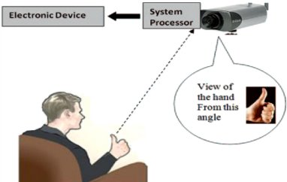
Objective
This project aims to develop a gesture-driven object manipulation system in Unity using YOLO, leveraging deep learning-based object detection for reliable gesture recognition. The system will enable real-time object control, improving interaction efficiency and user experience in 3D environments.

Slide 4
Methodology
Stream in webcam input in real time, convert it into frames using OpenCV.
Send the frames continuously to the YOLO model, which will detect an object(if present) and store it in a variable within python.
Using TCP sockets(used for smaller data), continually send the variable data to Unity. This method is better than Websockets(used in webpages), as the data synced is very small, having low latency.
The data is received in Unity, and by scripting in C#, we make the object previously imported into unity, to move according to the content/gesture detected in the variable synced.

Slide 5
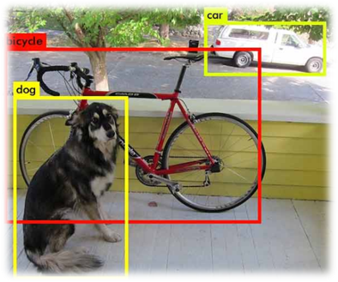
How YOLO works
Image resized & normalized.
Passes through backbone (CSPDarknet53) → extracts features.
Passes through neck (FPN + PAN) → refines features.
Passes through head → generates bounding boxes.
Post-processing (NMS + confidence thresholding).
Returns final detected objects with bounding boxes.

Slide 6
How YOLO works (Backbone –CSP(Cross Stage Partial) Darknet)
Convolutional Layer 1 – passes a weight matrix through the input image, generates feature map. Batch normalises feature map, decides how much the neuron is activated.
CSP Bottleneck Block – The input feature map is divided into two sets randomly. One set is sent directly to merging while another set goes through bottleneck layer, before merging.
Bottleneck layer – go through multiple convolutions.
Conv Layer 2 (Downsampling using Strided Conv)
Function: Reduce spatial dimensions (640 → 320).
CSP2 – 2 bottleneck blocks, etc.

Slide 7


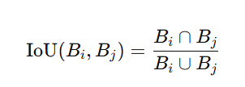
How YOLO works
Activation Functions
Non Max Supression:

Slide 8
How YOLO works :-(Neck (FPN +PAN))
Before the batch of images are sent to the neck layers SPP is done:-
SPP (Spatial Pyramid Pooling): for downsampling/reducing image size
Uses different sized filters for extracting different levels of abstract information.
Smaller filters/kernels get more details
Combine all the pooled feature maps by adjusting sizes
The Neck in YOLOv5 is responsible for multi-scale feature fusion, helping to detect objects of different sizes. It consists of:
⃣ FPN (Feature Pyramid Network)- Upsamples deeper layers and merges them with earlier layers PAN (Path Aggregation Network))- Enhances spatial details by reintroducing low-level features
These structures combine feature maps from different layers of the Backbone + SPP to ensure that both small and large objects are well detected.

Slide 9
How YOLO works :- (Head & NMS )
Once the Neck (FPN + PAN) processes multi-scale feature maps, the Head takes these features and does the following:-
Predictions are made (bounding boxes, objectness, and class scores).
Weights are applied from the trained model to generate meaningful detections.
Loss is calculated during training to optimize the mode
NMS(Non –Max Suppression)
The Head may predict multiple overlapping boxes for the same object.
NMS keeps only the most confident detection for each object. It does the Following:-
1) Remove low-confidence boxes
2) Sort by confidence (Prioritize best detections)
3) Compute IoU
4) Suppress Overlapping Boxes (If IoU > IoU threshold, discard the lower-confidence box.)

Slide 10



How YOLO works
Back propagation: Gradient Descent
(error)
Errors:
Bounding Box Loss:
Confidence Loss
Classification loss
After all these steps the a little bit of post processing is done and then classification results are sent to external systems for veiwing.

Slide 11

How OpenCV works
OpenCV asks OS for access to camera, uses default API (platform specific)
Webcam frames are stored in queue
When read fn is called, OpenCV takes the oldest frame from queue
It is then processed in python

Slide 12
How TCP Works
Python
1. Establishing the Connection (Handshake Process)
2. Socket creation and binding to address
Unity
1. Accepts connection
2. Receives data

Slide 13
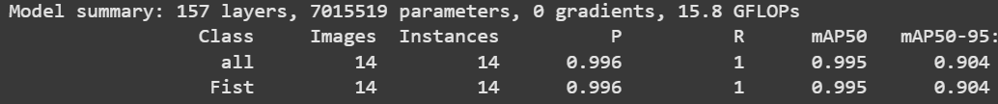
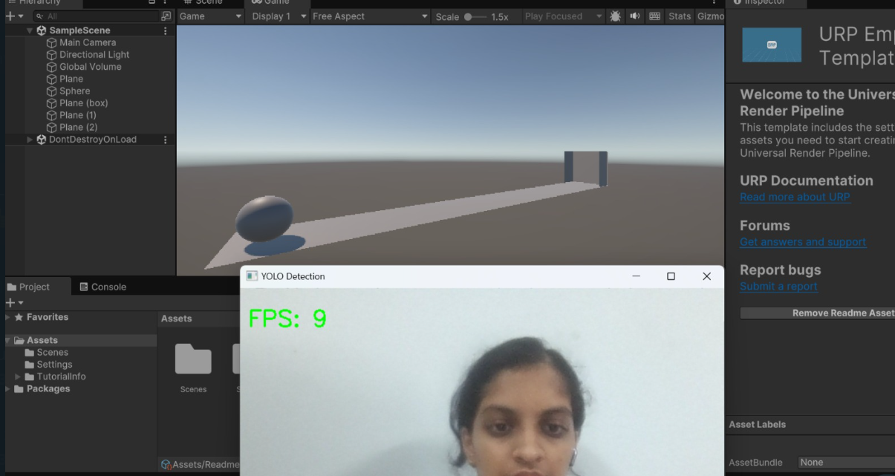
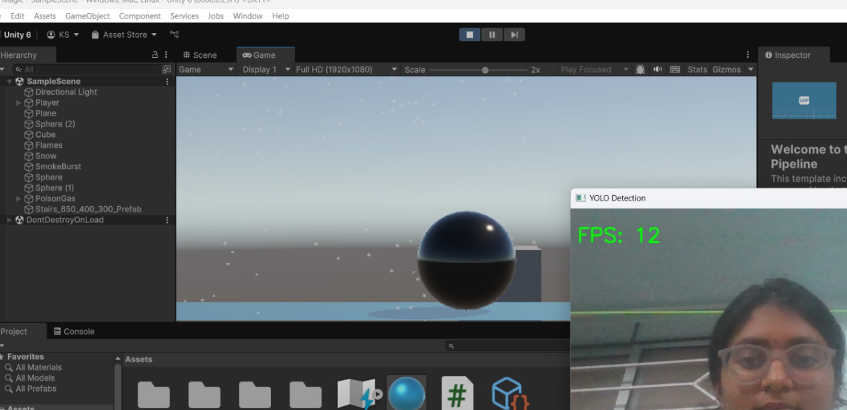
Results
Data set training results:-

Slide 14
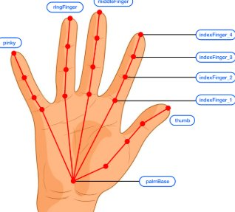
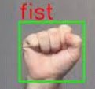
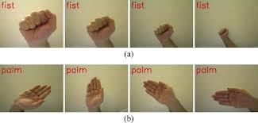
Future Work
We've got the whole project working with a pretrained model of yolov5, but the custom trained model is showing errors.
We will fix the errors and use the custom trained model, for proper gesture detection, instead of using the generalised pretrained classes

Slide 15
Timeline
1 week- setting up TCP, UDP, preparing custom dataset -done
1 week- Streaming in webcam input as frames to YOLO and checking for object detection -done
1 week- training YOLO with custom dataset and testing to ensure it detects gestures. -done
1 week- figuring out writing custom code in Unity -done
1 week- connecting YOLO's output in python to Unity in c#, using the TCP or UDP -done
1 week- testing it actually works
1 week- getting performance as close to real time as possible
Total: 6-7 weeks, ~1.5 to 2 months
THANK YOU !
We are Group 6..

